Slide 1
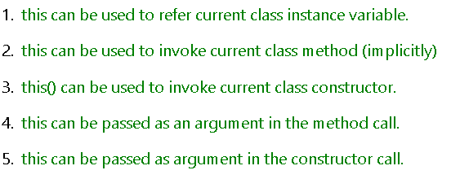
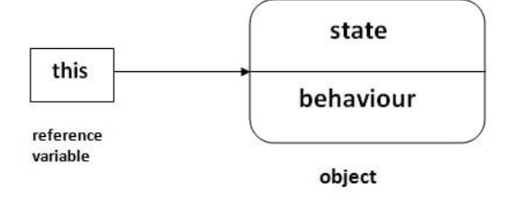
this keyword
this is a reference variable that refers to the current object.

Slide 2
Understanding the problem without this keyword
class Student{
int rollno;
String name;
float fee;
Student(int rollno,String name,float fee){
rollno=rollno;
name=name;
fee=fee;
}
void display(){System.out.println(rollno+" "+name+" "+fee);}
}
class TestThis1{
public static void main(String args[]){
Student s1=new Student(111,"ankit",5000f);
Student s2=new Student(112,"sumit",6000f);
s1.display();
s2.display();
}}
output
0 null 0.0
0 null 0.0

Slide 3
Understanding the problem without this keyword
parameters (formal arguments) and instance variables are same.
So, we are using this keyword to distinguish local variable and instance variable.

Slide 4
Solution of the above problem by this keyword
class Student{
int rollno;
String name;
float fee; // instance variables
Student(int rollno,String name,float fee){
this.rollno=rollno;
this.name=name;
this.fee=fee;
}
void display(){System.out.println(rollno+" "+name+" "+fee);}
}
class TestThis2{
public static void main(String args[]){
Student s1=new Student(111,"ankit",5000f);
Student s2=new Student(112,"sumit",6000f);
s1.display();
s2.display();
}}
111 ankit 5000.0
112 sumit 6000.0

Slide 5
Program where this keyword is not required
class Student{
int rollno;
String name;
float fee;
Student(int r,String n,float f){
rollno=r;
name=n;
fee=f; // formal arguments are different
}
void display(){System.out.println(rollno+" "+name+" "+fee);}
}
class TestThis3{
public static void main(String args[]){
Student s1=new Student(111,"ankit",5000f);
Student s2=new Student(112,"sumit",6000f);
s1.display();
s2.display();
}}
111 ankit 5000.0
112 sumit 6000.0

Slide 6
this: to invoke current class method
You may invoke the method of the current class by using the this keyword.
*
class A{
void m(){
System.out.println("hello m");
}
void n()
{
System.out.println("hello n");
//m();//same as this.m()
this.m();
}
}
class TestThis4{
public static void main(String args[]){
A a=new A();
a.n();
}}
Output:
hello n
hello m

Slide 7
this() : to invoke current class constructor
class A{
A()
{
System.out.println("hello a");
}
A(int x)
{
this();
System.out.println(x);
}
}
class TestThis5{
public static void main(String args[]){
A a=new A(10);
}}
hello a
10

Slide 8
Default Constructor
A constructor is called "Default Constructor" when it doesn't have any parameter.
Purpose:
The default constructor is used to provide the default values to the object like 0, null, etc., depending on the type.
If there is no constructor in a class, compiler automatically creates a default constructor.
class Bike1{
//creating a default constructor
Bike1(){System.out.println("Bike is created");}
//main method
public static void main(String args[]){
//calling a default constructor
Bike1 b=new Bike1();
}
}
0utput
Bike is created

Slide 9
Java Parameterized Constructor
A constructor which has a specific number of parameters is called a parameterized constructor.
USE:The parameterized constructor is used to provide different values to distinct objects. However, you can provide the same values also.
class Student4
{
int id;
String name;
//creating a parameterized constructor
Student4(int i,String n){
id = i;
name = n;
}
//method to display the values
void display(){System.out.println(id+" "+name);}

Slide 10
public static void main(String args[])
{
//creating objects and passing values
Student4 s1 = new Student4(111,"Karan");
Student4 s2 = new Student4(222,"Aryan");
//calling method to display the values of object
s1.display();
s2.display();
}
}
111 Karan
222 Aryan

Slide 11
Java Copy Constructor
class Student7
{
int id;
String name;
Student7(int i,String n)
{
id = i;
name = n;
}
Student7()
{}
void display(){System.out.println(id+" "+name);
}
public static void main(String args[])
{
Student7 s1 = new Student7(111,"Karan");
Student7 s2 = new Student7();
s2.id=s1.id;
s2.name=s1.name;
s1.display();
s2.display();
}
}
111 Karan
111 Karan

